Slide 1
Hybrid governance in Congo’s large-scale gold mining concessions Sara Geenen Conference Transition and Local Development in Eastern DRC, 8-10 December 2016

Slide 2
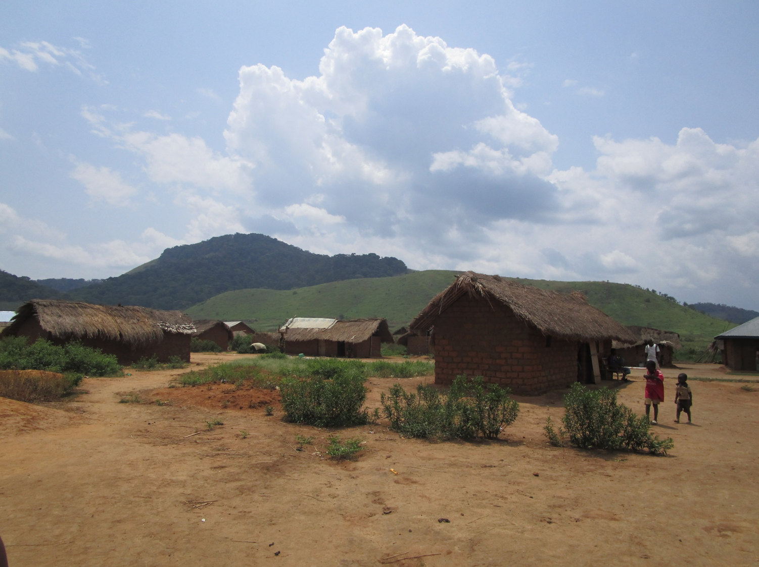
Theory and research question: company-community relations and hybrid governance
Methodology: qualitative field research and power mapping
Analysis: development outcomes for local communities

Slide 3
Theory
Companies | Communities | Governments
Needs a ‘social license to operate’
Fragmented responses: CSR, negociations (inclusion/exclusion)
De facto governments?

Slide 4
Theory
Companies | Communities | Governments
Needs a ‘social license to operate’ | Has expectations
Fragmented responses: CSR, negociations (inclusion/exclusion) | Fragmented responses: negotiation/ inclusion, exclusion/frustration/conflict
De facto governments? | ‘Practical arrangements’ at the local level

Slide 5
Theory
Companies | Communities | Governments
Needs a ‘social license to operate’ | Has expectations | Grants concession
Fragmented responses: CSR, negotiation (inclusion/exclusion) | Fragmented responses: negotiation/ inclusion, exclusion/frustration/conflict | Fragmented responses: regulation by law, contracts, international regulations
De facto governments? | ‘Practical arrangements’ at the local level | Transfer of governance responsibilities?

Slide 6
Research question
Companies | Communities | Governments
Needs a ‘social license to operate’ | Has expectations | Grants concession
Fragmented responses: CSR, negotiation (inclusion/exclusion) | Fragmented responses: negotiation/ inclusion, exclusion/frustration/conflict | Fragmented responses: regulation by law, contracts, international regulations
De facto governments? | ‘Practical arrangements’ at the local level | Transfer of governance responsibilities?
Hybrid governance
Community development

Slide 7
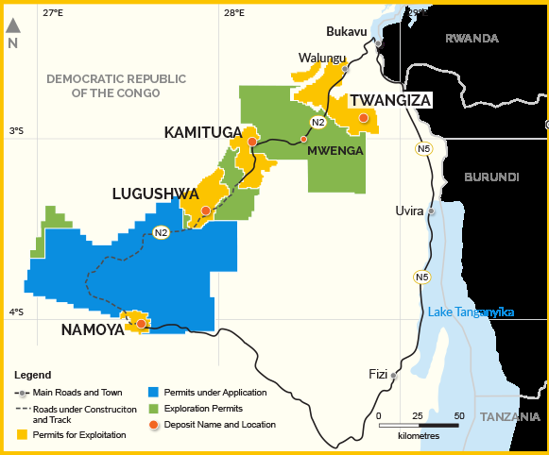
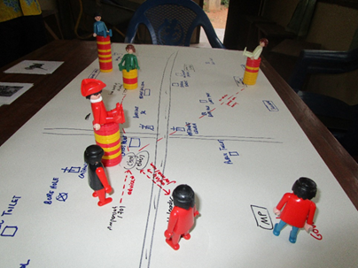
Methodology
Case study
Field research September 2015
Individual interviews
Focus group interviews
Source: www.banro.com

Slide 8
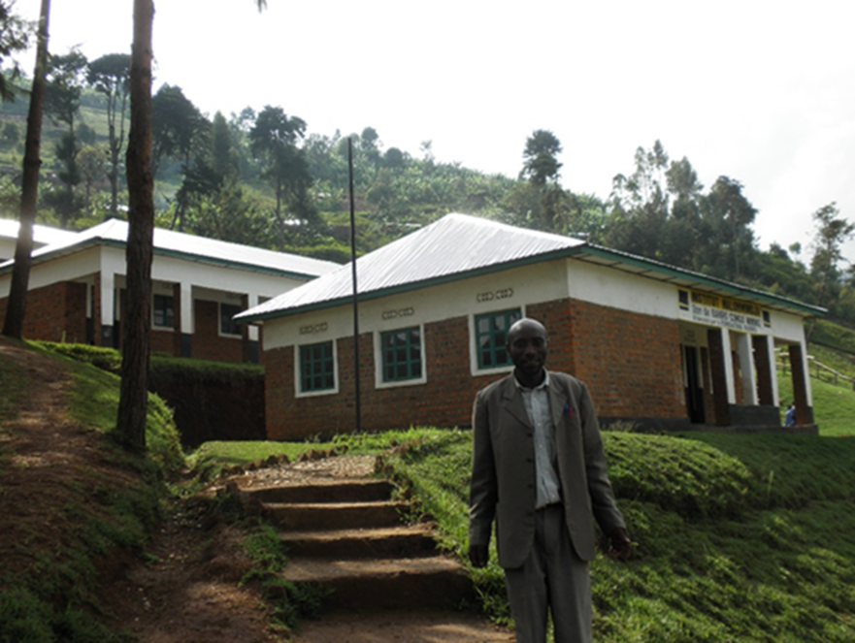
Analysis
‘Spaces’ for community development
Work
Subcontracting
Socio-environmental externalities
Forced displacement and compensation
CSR interventions
Redistribution of mining rents
School in Luhwindja, picture by Sara Geenen

Slide 9
Analysis
‘Spaces’ for community development
Work
Company: recruitment policy
Forum Communautaire
Sous-comité d’emploi
Government: local content
Community: who is ‘local’
Hybrid governance

Slide 10
Analysis
Company-community encounters characterized by conflict or collaboration, depending on
Geology, ecology and economy of mining project
Intra-community diversity
Local and national politics
Individual practices and company policies

Slide 11
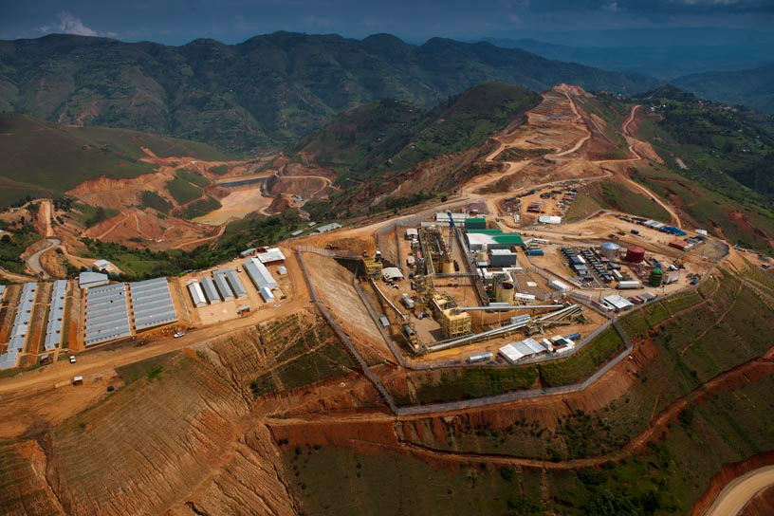
Geology, ecology and economy of the mining project
Source: www.banro.com

Slide 12
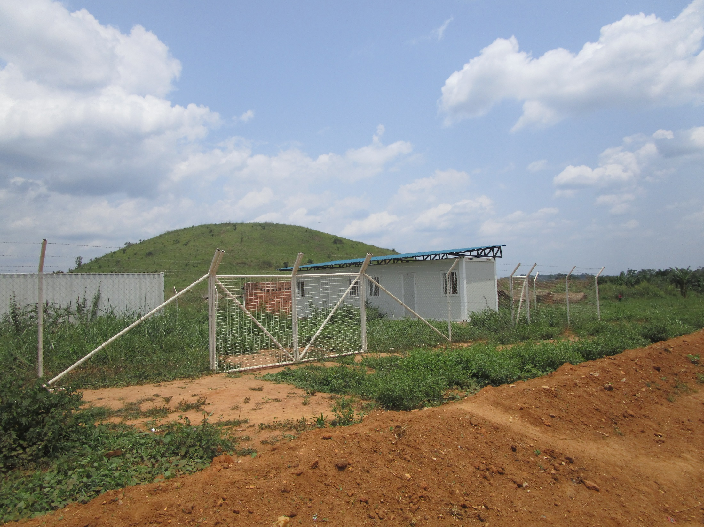
Intra-community diversity
Artisanal miners

Slide 13
Intra-community diversity
Artisanal miners
ZEA Matete cooperative
Continue as illegal miners
Other mining sites
Other activities

Slide 14
Intra-community diversity
Cooperatives
“That is when the white people came with their promises: we will come with machines for exploitation , for processing, and we will buy your gold. We accepted. But they left and never came back. When you speak to them, they will say that they gave us a lot. All lies!”

Slide 15
Local and national politics

Slide 16
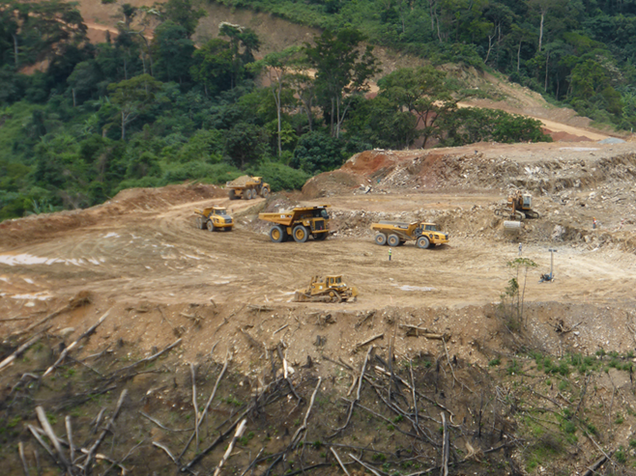
Individual practices and company policies
Picture www.banro.com

Slide 17
Individual practices and company policies
"They are smart. Whenever they have trouble with the population, they identify the main trouble maker and quickly call him in order to buy him off. Try to organize a march against Banro today, tomorrow they will give you a job”.
Picture www.banro.com

Slide 18
Thank you!
Sara.geenen@uantwerpen.be
Implications for local development
Acknowledgement of intra-community diversity and individual practices
Attention for political conflicts and mechanisms of exclusion
Attention for geology, ecology and economy of the mining project
Hybrid governance: effectiveness and legitimacy?

